Slide 1
Gestures
DMIT 2504 Week 4 day 2

Slide 2





Announcements

Slide 3
Assignment 1 Review
Notes:
Common issues:
Not validating the sunrise and sunset month and year (no marks docked)
Not validating in the constructors
Putting a check in to see if the sunrise and sunset have been initialized before validating
Not converting the api output to ints
No marks deducted (throwing an exception inside of a try catch)

Slide 4
Expectations
No Late Assignments
No Cheating
Be a good classmate
Don’t go to stupid sites in class
Show up to class

Slide 5
What is a gesture?
Notes:
Drags
Taps
Pinches
Long presses
Double taps

Slide 6

Pointer vs Gesture Layer
Flutter has 2 separate layers for gesture handling
The pointer layer has events that describe raw pointer actions
Pointers: PointerDown, PointerMove, PointerUp
The Gesture layer abstracts out the raw pointer events to give more semantic actions
Gestures: Tap, DoubleTap, Scale, Drag
We will primarily focus on gestures in this class

Slide 7
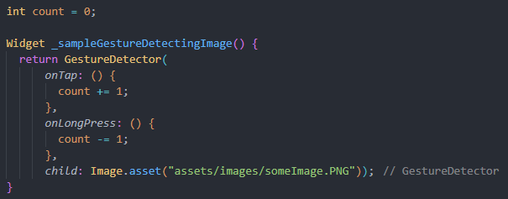
Detecting Gestures
There’s a handy widget called the GestureDetector
It has a child parameter which will be used to display the widget that is doing the detecting
It also has parameters for every gesture type that can be passed callbacks to handle the gestures

Slide 8

Gesture Docs
https://docs.flutter.dev/ui/interactivity/gestures

Slide 9
Built in Gesture Detection
Many widgets have gestures built into the widget so you won’t need GestureDetector
For example the ElevatedButton widget has the onPressed property that detects presses and calls the callback function

Slide 10
Lifecycle
CreateState()
Widget Added to Tree
build()
InitState()
setState()
Build()
build()
Widget Removed from Tree
dispose()
Notes:
InitState should be where you put any setup
Dispose is where you should put any cleanup (disconnect from db, cancel ongoing requests)

Slide 11
Mounted
Stateful widgets have a special property called mounted
Mounted is a Boolean flag
It tells you if the widget is still in the tree
It is set to true by initState and set to false by dispose
If you are setting state in response to an external event (fetch call, db change) you should check if mounted before setting state

